Slide 1
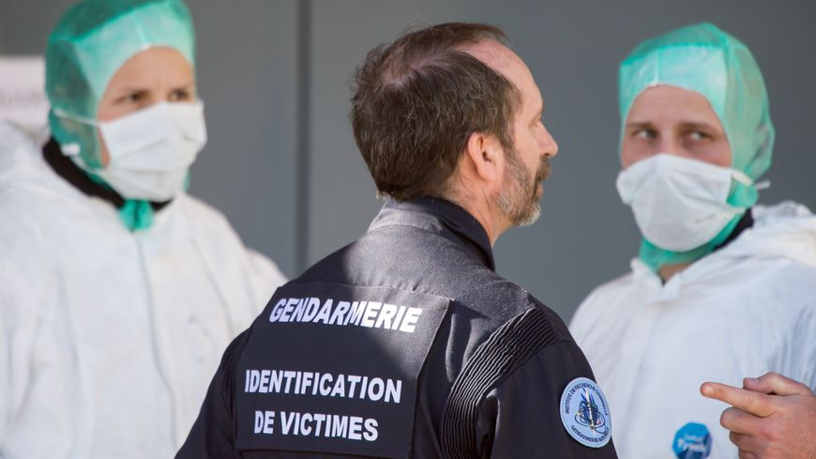
Aren’t management issues part of the solution to the forensic science crisis?

Slide 2
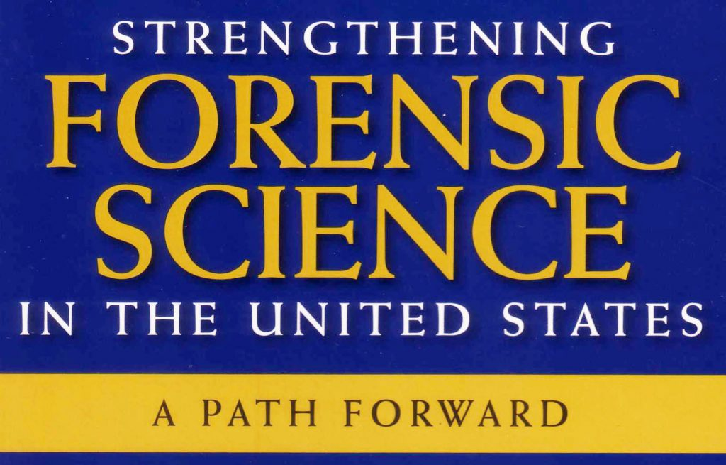
Which crisis? (1/2)
Cf. NAS report 2009.
Some recommandations:
Remove crime labs from administrative control of law enforcement & prosecutors (4).
Research in forensic science and bias (5).
Mandatory accreditation & certification (7).
Improve forensic science education; more fellowships, research grants (10).
-> Aren’t these recommandations related to management?

Slide 3
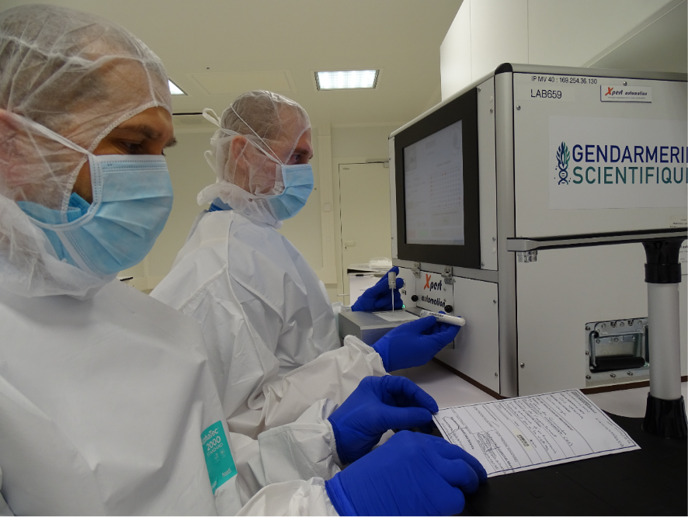
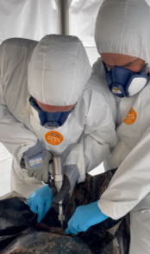
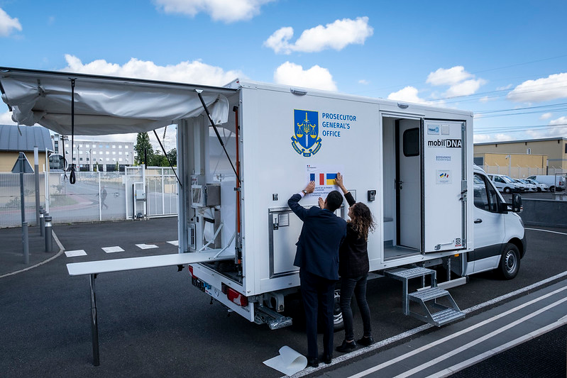
Which crisis? (2/2)
The crisis is neither a:
technical one (sophisticated accurate & precise machines, QM implemented)
mission one (missions can be explained and clarified)
expert one (many are educated, certified, working under QM regulations)
What if it were a management one?

Slide 4
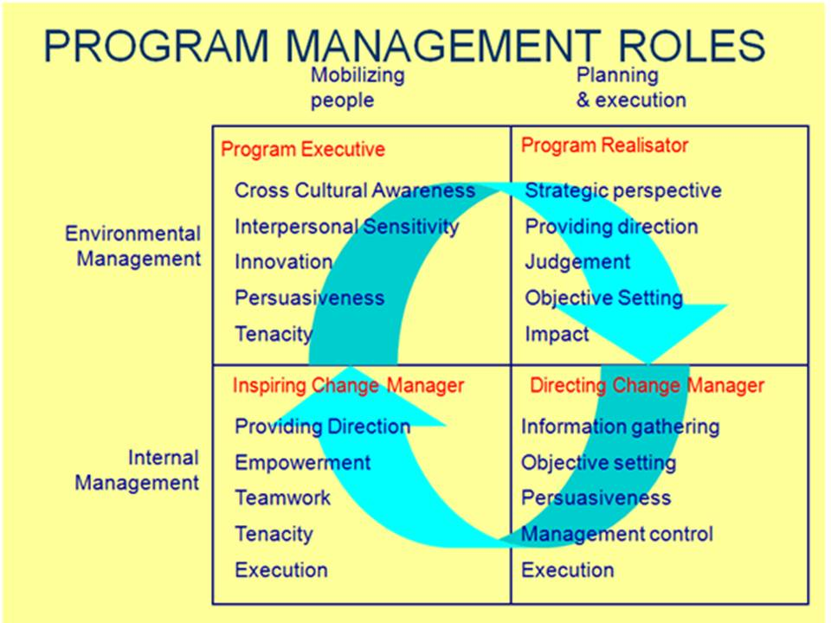
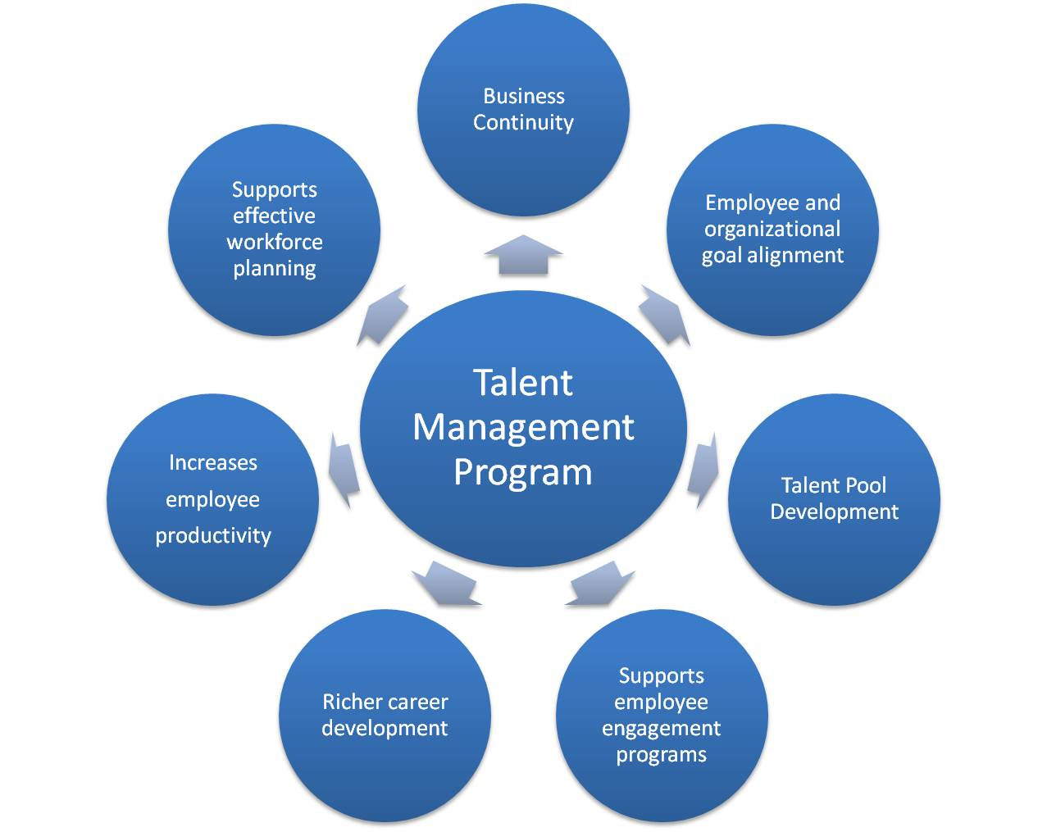
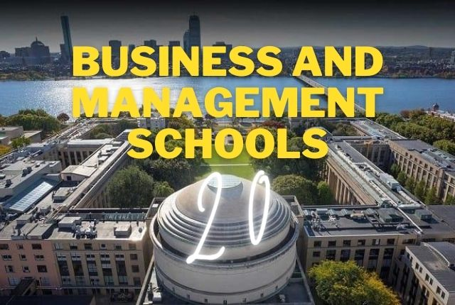
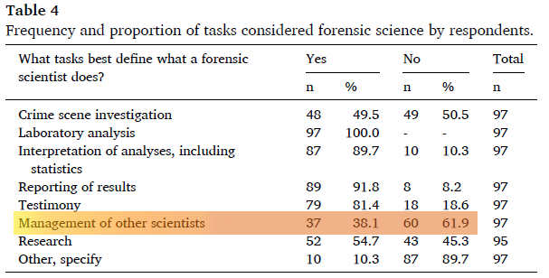
Could it be a management one?
Management consists in organizing, conducting, regulating & administrating.
It would be paradoxal to affirm the existence of this management crisis because we have at our disposal:
management tools
management educational programs
management schools
But (Wim Neuteboom et al., Quality management…):

Slide 5
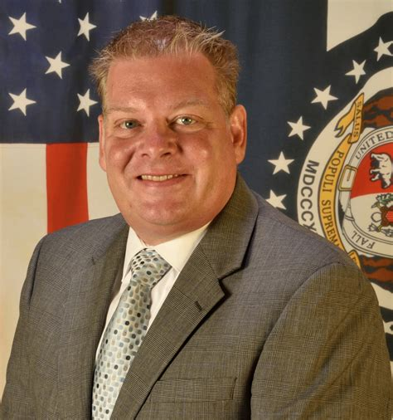
Management challenges (1/2)
Quick poll: do bad managers exist?
Brian Hoey: “How did I get to be such a good DNA person? I went to school for four years and got a biology degree. And I went for two years and got a master’s degree. To be a good leader, I am probably going to have to invest that much or similar amount of time in my leadership. I decided to get a master’s in business. I changed course in the meetings that I attended. I stopped going to general meetings and started to go to leadership conferences.” https://www.ishinews.com/leading-the-lab-insights-from-those-in-management/
Need of a management course stated by practitioners & academics:

Slide 6
Management challenges
A manager in forensic science has to manage:
techniques (buying & replacing machines)
experts who don’t need to be taught again in their speciality
decentralization (Casey, 2019, The Kodak Syndrom: Risks & Opportunities Created by Decentrallzation of Forensic Capabilities)
research & development (Weyermann et al., 2022, Towards More Relevance in
Forensic Research & development)
Hence, what about an informed, uneducated
manager in forensic science ?

Slide 7
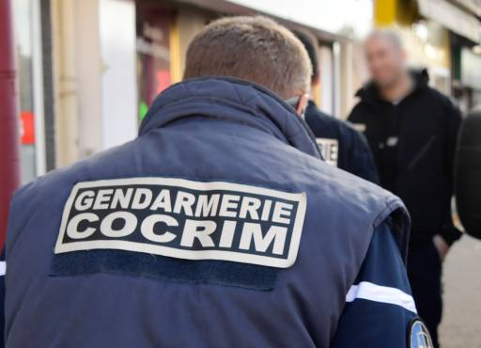
Solving the problem?
Can we manage what we ignore?
- Necessity to teach young experts what forensic science is.
-> creation of an initial forensic course for people recently assigned to PJGN.
Can we manage experts as we manage « ordinary people »?
Manager in forensic science should act like an orchestra conductor
-> creation of a MBA dedicated to forensic science.
Objective: get managers in forensic science able to manage a
forensic service.

